Slide 1
Making the SELECT statement more powerful
Data Manipulation Language

Slide 2
Learning Objectives
By the end of this lesson you will have :
A clearer understanding of how the SELECT statement works
Know how to use comparators in a query
Know how to sort the output of a query
Understand the concept of Foreign Key
Be able to implement the Foreign Key constraint
Use Inner Join to develop more powerful select statements

Slide 3
Relational Database
Data is organized into tables
Rows and Columns or Records and Fields
Tuples and Attributes (Relational Theory)
Each table usually represents a ‘thing’ we are interested in storing data about
Each row represents a single occurrence of this ‘thing’
Each column represents a piece of data we want to store about this ‘thing’
Each column can only store data of a particular type

Slide 4
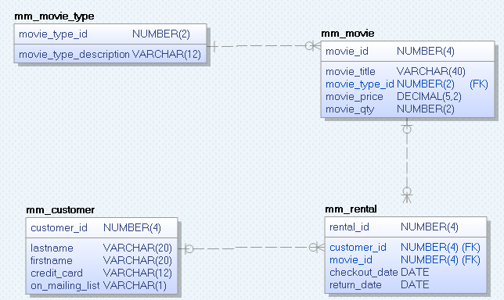
Movie Rental Shop
mm_movie_type(
move_type_id, movie_type_description)
mm_movie(
movie_id,
movie_title,movie_type_id, movie_price, movie_qty)
mm_customer(
customer_id,
lastname, firstname, credit_card, on_mailing_list)
mm_rental(
rental_id,
customer_id, movie_id, checkout_date, return_date)

Slide 5
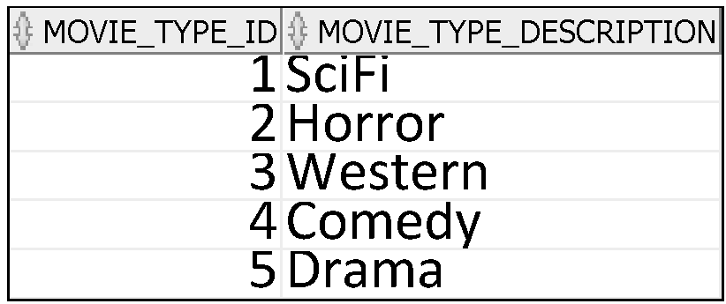
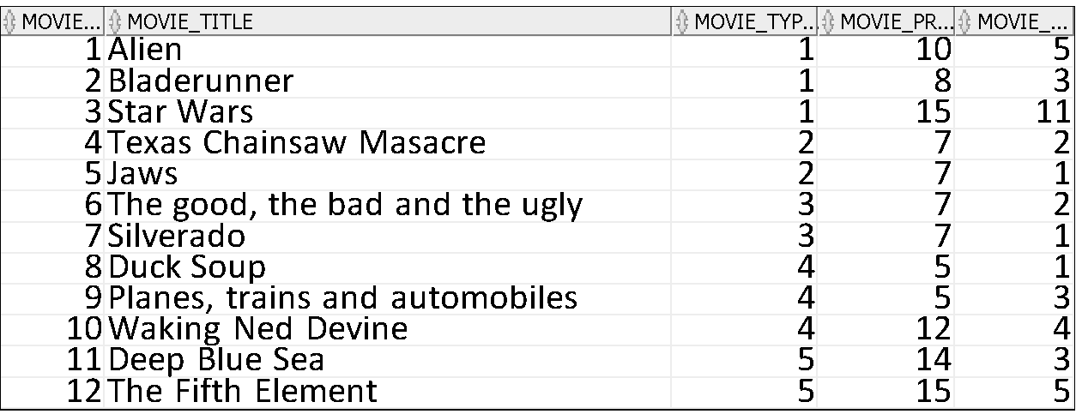
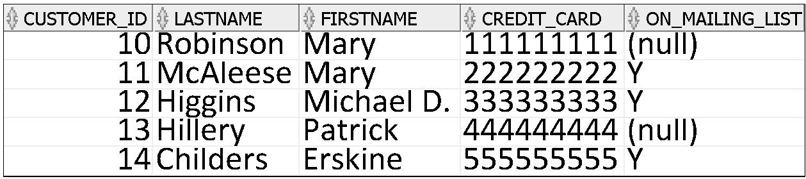
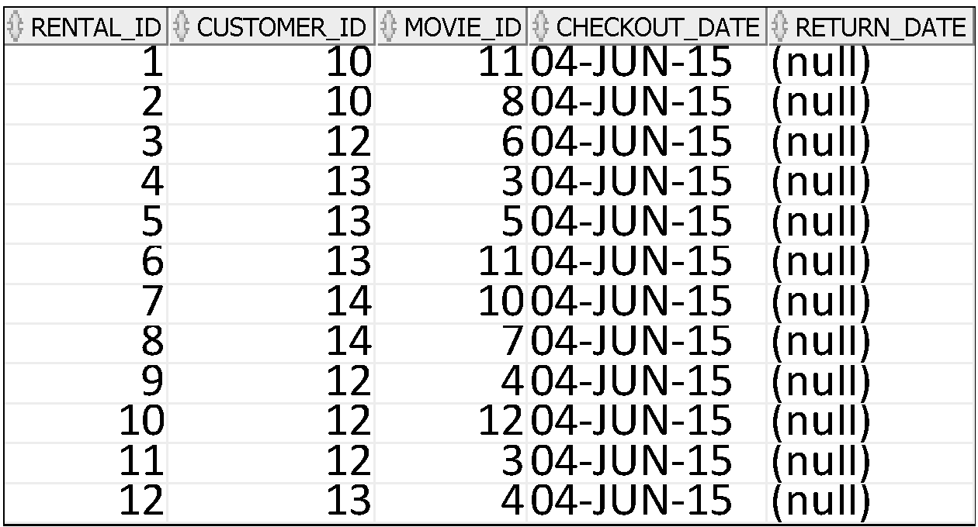
Movie Rental Shop
Movie Types
mm_movie_type
Movies
mm_movie
Customers
mm_customer
Rentals
mm_rental

Slide 6
Data types
Each value manipulated by Oracle has a DataType.
There are 4 main types of data
Characters or character strings
Numeric Data
Data and time
Binary
Each column in a relational database can hold only one type of data.
You cannot mix data types within a column.

Slide 7
Data types
In SQL:
Different types of data have different types of characteristics, the purpose of which is to efficiently store data.
By defining your data structures efficiently you are facilitating improved efficiency in your application programming.
Different data types offer several advantages:
Columns of a single type produce consistent results.
For example, DATE data type columns always produce date values.
You cannot insert the wrong type of data into a column.
For example, columns of data type DATE will prevent NUMBER type data from being inserted.

Slide 8
Numeric data types
The NUMBER data type is used to store negative, positive, integer, fixed-decimal, and floating-point numbers.
NUMBER(n) where n is an integer value.
This denotes a number n digits long.
E.g. Phone_no NUMBER(12)

Slide 9
Numeric data types
To store decimal numbers we still use Number but we must supply
Precision is the total number of significant digits in the number, both to the left and to the right of the decimal point.
Scale is the total number of digits to the right of the decimal point.
NUMBER (n,m) where n, m are integer values.
This denotes a decimal number, with n digits in total, m after the decimal place.
E.g.
CostPrice NUMBER(7,2)
It basically means 7 numbers, 2 of which are after the decimal place can be stored in the column CostPrice
Allows the column to hold values up to 99999.99

Slide 10
Character data types
CHAR
This denotes a single character.
Example: GENDER CHAR
CHAR(n) where n is an integer value.
This denotes a n-character fixed length string.
If data is inserted that does not have the required number, the remaining characters are padded with blanks.
Alphanumeric characters are allowed.
Example:
StudentNo CHAR(9)
If we insert the value 123 what will actually be stored is 123 plus 6 spaces – ‘123 ‘
When inserting values into character columns, surround the value by single quotes.

Slide 11
Character data types
VARCHAR2 is our preferred datatype for character data longer than a single character
VARCHAR2(n) where n is an integer value.
This denotes a variable length string, with a maximum length of n.
If the data are smaller than the specified size, only the data value is stored, and trailing spaces are not added to the value.
Alphanumeric characters are allowed.
Example: StudentName VARCHAR2(30).
When inserting values into character columns, surround the value by single quotes.
Example:
StudentNo VARCHAR2(9)
If we insert the value 123 what will actually be stored is 123 – ‘123’

Slide 12
Date Time DataType
DATE
This denotes a date AND TIME field.
It holds the date and time correct to a second.
The datatype DATE suffices for most purposes.
Stores a value of centuries down to whole seconds, but cannot store fractions of a second.
’21-AUG-2013 17:25:30’ is a valid value
When comparing dates, remember that two dates with the same day may be different
The hours, minutes or seconds may differ
So we will need to do some work on date fields in advance of comparing to ensure our comparisons make sense
We can indicate the formal we want dates output in e.g. ‘DD-MMM-YY’ or DD-MM-YY or YY-MM-DD
E.g. ‘01-JAN-10’ or 01-01-10 or 10-01-01

Slide 13
Date Time DataType
The current system date is held in a variable called SYSDATE
You can use this to set default values for data input or use it in SELECT statements either in the columns or as part of a comparison in the WHERE clause
To find out the current date you can use a select statement
SELECT SYSDATE FROM DUAL;
DUAL is a dummy table from which you can get results from system functions.
Can use it for other things e.g. select 3+4 as “Result” from dual;

Slide 14
Date Time DataType
The TIMESTAMP data type is an extension of the DATE data type which allows fractions of a second.
It stores the year, month, and day of the DATE data type plus hour, minute, and second values as well as the fractional second value.
For example, TIMESTAMP(3) allows 3 digits after the whole seconds, allowing values down to milliseconds to be stored.
Be careful!
Select systimestamp from dual;
Current Date and Time

Slide 15
Data Types
Data Type | Description
VARCHAR2(size) | Variable-length character data
CHAR(size) | Fixed-length character data
NUMBER(p,s) | Variable-length numeric data
DATE
LONG | Variable-length character data (up to 2 GB)
CLOB | Character data (up to 4 GB)
RAW and LONG RAW | Raw binary data
BLOB | Binary data (up to 4 GB)
BFILE | Binary data stored in an external file (up to 4 GB)
ROWID | A base-64 number system representing the unique address of a row in its table
Notes:
Data Types
When you identify a column for a table, you need to provide a data type for the column. There are several data types available:

Slide 16
Datetime Data Types
You can use several datetime data types:
Data Type | Description
DATE | Date and time values
TIMESTAMP | Date with fractional seconds
INTERVAL YEAR TO MONTH | Stored as an interval of years and months
INTERVAL DAY TO SECOND | Stored as an interval of days, hours, minutes, and seconds
Notes:
Other Datetime Data Types
Note: These datetime data types are available with Oracle9i and later releases. For detailed information about the datetime data types, see the topics “TIMESTAMP Datatype,” “INTERVAL YEAR TO MONTH Datatype,” and “INTERVAL DAY TO SECOND Datatype” in the Oracle SQL Reference.

Slide 17
Where are the Booleans?
Oracle SQL does not support a Boolean datatype.
You have to use a workaround.
You can mimic Booleans by using a single character CHAR(1) or a single number NUMBER(1)

Slide 18




What Is a LOB?
LOBs are used to store large unstructured data such as text, graphic images, films, and sound waveforms.
“Four score and seven years ago our fathers brought forth upon this continent, a new nation, conceived in LIBERTY, and dedicated to the proposition that all men are created equal.”
Movie (BFILE)
Text (CLOB)
Photo (BLOB)
Notes:
LOB: Overview
A LOB is a data type that is used to store large, unstructured data such as text, graphic images, video clippings, and so on. Structured data, such as a customer record, may be a few hundred bytes, but even small amounts of multimedia data can be thousands of times larger. Also, multimedia data may reside in operating system (OS) files, which may need to be accessed from a database.
There are four large object data types:
BLOB represents a binary large object, such as a video clip.
CLOB represents a character large object.
NCLOB represents a multibyte character large object.
BFILE represents a binary file stored in an OS binary file outside the database. The BFILE column or attribute stores a file locator that points to the external file.
LOBs are characterized in two ways, according to their interpretations by the Oracle server (binary or character) and their storage aspects. LOBs can be stored internally (inside the database) or in host files. There are two categories of LOBs:
Internal LOBs (CLOB, NCLOB, BLOB): Stored in the database
External files (BFILE): Stored outside the database

Slide 19
The SELECT statement revisited
SELECT columns FROM tables WHERE condition;
To use a select statement we need to know:
The pieces of data we want the DBMS to show us in the output once the SELECT statement is executed (columns)
The table(s) that the DBMS should look in to find those pieces of data (tables)
The condition we want the DBMS to use to filter the rows of data it uses to construct the output (showing the columns we have indicated for each row)(conditions)

Slide 20
How does it work?
The SELECT statement is a Query
For each Query the DBMS
Creates a temporary table
Its structure is the set of columns you have indicated
It populates it with values from the columns in the tables you indicated
If you have a where clause, it only inserts data that matches the condition you specify
If you run the SELECT as a single statement
Your output will be in the form of a table
If you run it as a Script
Your output will look like a report

Slide 21
Character Strings and Dates
Character strings and date values are enclosed by single quotation marks.
Character values are case-sensitive,
Date values are format-sensitive.
The default date format is DD-MON-RR.
SELECT movie_price
FROM mm_movie
WHERE movie_title = 'Jaws' ;

Slide 22
Comparison Conditions
Operator | Meaning
= | Equal to
> | Greater than
>= | Greater than or equal to
< | Less than
<= | Less than or equal to
<> | Not equal to
BETWEEN ...AND... | Between two values (inclusive)
IN(set) | Match any of a list of values
LIKE | Match a character pattern
IS NULL | Is a null value
Notes:
Comparison Conditions
Comparison conditions are used in conditions that compare one expression to another value or expression. They are used in the WHERE clause in the following format:
Syntax
... WHERE expr operator value
Example
... WHERE hire_date = '01-JAN-95'
... WHERE salary >= 6000
... WHERE last_name = 'Smith'
An alias cannot be used in the WHERE clause.
Note: The symbols != and ^= can also represent the not equal to condition.

Slide 23
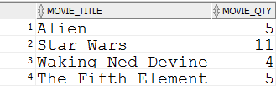
Using Comparison Conditions
SELECT movie_title, movie_qty
FROM mm_movie
WHERE movie_qty >3 ;

Slide 24
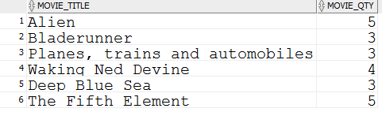
Using the BETWEEN Condition
Use the BETWEEN condition to display rows based on a range of values:
SELECT movie_title, movie_qty
FROM mm_movie
WHERE movie_qty BETWEEN 3 and 5;
Lower limit
Upper limit

Slide 25
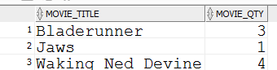
Using the IN Condition
Use the IN membership condition to test for values in a list:
SELECT movie_title, movie_qty
FROM mm_movie
WHERE movie_title IN (‘Jaws’, ‘Bladerunner’, ‘Waking Ned Devine’) ;
Notes:
Using the IN Condition
To test for values in a specified set of values, use the IN condition. The IN condition is also known as the membership condition.

Slide 26

Using the IN Condition
Use the IN membership condition to test for values in a list:
SELECT movie_title, movie_qty
FROM mm_movie
WHERE movie_qty IN (1,5,11);
Notes:
Using the IN Condition
To test for values in a specified set of values, use the IN condition. The IN condition is also known as the membership condition.
The slide example displays employee numbers, last names, salaries, and manager’s employee numbers for all the employees whose manager’s employee number is 100, 101, or 201.
The IN condition can be used with any data type. The following example returns a row from the EMPLOYEES table for any employee whose last name is included in the list of names in the WHERE clause:
SELECT employee_id, manager_id, department_id
FROM employees
WHERE last_name IN ('Hartstein', 'Vargas');
If characters or dates are used in the list, they must be enclosed by single quotation marks ('').

Slide 27
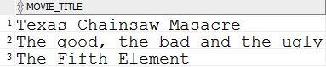
Using the LIKE Condition
Use the LIKE condition to perform wildcard searches of valid search string values.
Search conditions can contain either literal characters or numbers:
% denotes zero or many characters.
_ denotes one character.
SELECT movie_title
FROM mm_movie
WHERE movie_title LIKE 'T%' ;
Every title that starts with an uppercase T
Notes:
Using the LIKE Condition
You may not always know the exact value to search for. You can select rows that match a character pattern by using the LIKE condition. The character pattern–matching operation is referred to as a wildcard search. Two symbols can be used to construct the search string.
The SELECT statement in the slide returns the employee first name from the EMPLOYEES table for any employee whose first name begins with the letter S. Note the uppercase S. Names beginning with an s are not returned.
The LIKE condition can be used as a shortcut for some BETWEEN comparisons. The following example displays the last names and hire dates of all employees who joined between January 1995 and December 1995:
SELECT last_name, hire_date
FROM employees
WHERE hire_date LIKE '%95';

Slide 28

Using the LIKE Condition
SELECT movie_title
FROM mm_movie
WHERE movie_title LIKE ‘%t%' ;
Every title with a lowercase t anywhere in the title
Notes:
Using the LIKE Condition
You may not always know the exact value to search for. You can select rows that match a character pattern by using the LIKE condition. The character pattern–matching operation is referred to as a wildcard search. Two symbols can be used to construct the search string.
The SELECT statement in the slide returns the employee first name from the EMPLOYEES table for any employee whose first name begins with the letter S. Note the uppercase S. Names beginning with an s are not returned.
The LIKE condition can be used as a shortcut for some BETWEEN comparisons. The following example displays the last names and hire dates of all employees who joined between January 1995 and December 1995:
SELECT last_name, hire_date
FROM employees
WHERE hire_date LIKE '%95';

Slide 29

Using the LIKE Condition
You can combine pattern-matching characters:
SELECT movie_title
FROM mm_movie
WHERE movie_title LIKE '_a%' ;
Every title with the letter a (lowercase) as its second letter
Notes:
Combining Wildcard Characters
The % and _ symbols can be used in any combination with literal characters. The example in the slide displays the names of all employees whose last names have the letter o as the second character.
ESCAPE Option
When you need to have an exact match for the actual % and _ characters, use the ESCAPE option. This option specifies what the escape character is. If you want to search for strings that contain ‘SA_’, you can use the following SQL statement:
SELECT employee_id, last_name, job_id
FROM employees WHERE job_id LIKE '%SA\_%' ESCAPE '\';
The ESCAPE option identifies the backslash (\) as the escape character. In the pattern, the escape character precedes the underscore (_). This causes the Oracle Server to interpret the underscore literally.

Slide 30
Using the LIKE Condition
You can use the ESCAPE identifier to search for the actual % and _ symbols.
Will return movies with a title that contains T_
SELECT movie_title
FROM mm_movie
WHERE movie_title LIKE '%T\_%' ESCAPE '\';
Notes:
Combining Wildcard Characters
The % and _ symbols can be used in any combination with literal characters. The example in the slide displays the names of all employees whose last names have the letter o as the second character.
ESCAPE Option
When you need to have an exact match for the actual % and _ characters, use the ESCAPE option. This option specifies what the escape character is. If you want to search for strings that contain ‘SA_’, you can use the following SQL statement:
SELECT employee_id, last_name, job_id
FROM employees WHERE job_id LIKE '%SA\_%' ESCAPE '\';
The ESCAPE option identifies the backslash (\) as the escape character. In the pattern, the escape character precedes the underscore (_). This causes the Oracle Server to interpret the underscore literally.

Slide 31
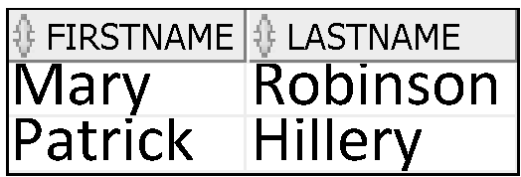
Using the NULL Conditions
Test for nulls with the IS NULL operator.
SELECT firstname, lastname
FROM mm_customer
WHERE on_mailing_list IS NULL ;
Notes:
Using the NULL Conditions
The NULL conditions include the IS NULL condition and the IS NOT NULL condition.
The IS NULL condition tests for nulls. A null value means the value is unavailable, unassigned, unknown, or inapplicable. Therefore, you cannot test with = because a null cannot be equal or unequal to any value.
…

Slide 32
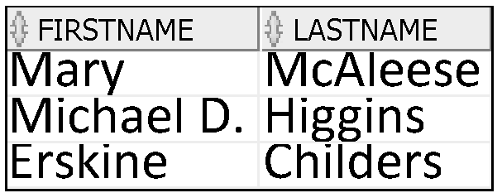
Using the NULL Conditions
Test for non null values with the IS NOT NULL operator.
SELECT firstname, lastname
FROM mm_customer
WHERE on_mailing_list IS NOT NULL ;
Notes:
Using the NULL Conditions
The NULL conditions include the IS NULL condition and the IS NOT NULL condition.
The IS NULL condition tests for nulls. A null value means the value is unavailable, unassigned, unknown, or inapplicable. Therefore, you cannot test with = because a null cannot be equal or unequal to any value.
…

Slide 33
Logical Conditions

Slide 34
Logical Conditions
Operator | Meaning
AND | Returns TRUE if both component conditions are true
OR | Returns TRUE if either component condition is true
NOT | Returns TRUE if the following condition is false
Notes:
Logical Conditions
A logical condition combines the result of two component conditions to produce a single result based on those conditions, or it inverts the result of a single condition. A row is returned only if the overall result of the condition is true.
Three logical operators are available in SQL:
AND
OR
NOT
All the examples so far have specified only one condition in the WHERE clause. You can use several conditions in one WHERE clause using the AND and OR operators.

Slide 35
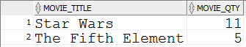
Using the AND Operator
AND requires both conditions to be true:
SELECT movie_title, movie_qty
FROM mm_movie
WHERE movie_qty >=5
AND movie_title LIKE '%t%' ;
Notes:
Using the AND Operator
In the example, both conditions must be true for any record to be selected. Therefore, only employees who have a job title that contains the string ‘MAN’ and earn $10,000 or more are selected.
All character searches are case-sensitive. No rows are returned if ‘MAN’ is not uppercase. Character strings must be enclosed by quotation marks.
AND Truth Table
The following table shows the results of combining two expressions with AND:

Slide 36
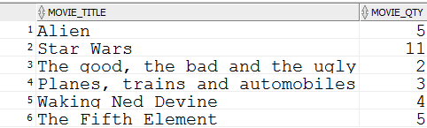
Using the OR Operator
OR requires either condition to be true:
SELECT movie_title, movie_qty
FROM mm_movie
WHERE movie_qty >=5
OR movie_title LIKE '%t%' ;
Notes:
Using the OR Operator
In the example, either condition can be true for any record to be selected. Therefore, any employee who has a job ID that contains the string ‘MAN’ or earns $10,000 or more is selected.
OR Truth Table
The following table shows the results of combining two expressions with OR:

Slide 37
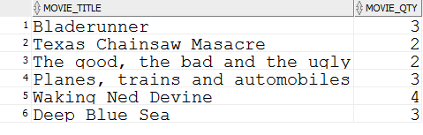
Using the NOT Operator
SELECT movie_title, movie_qty
FROM mm_movie
WHERE movie_qty NOT IN (1,5,11);
Notes:
Using the NOT Operator
The slide example displays the last name and job ID of all employees whose job ID is not IT_PROG, ST_CLERK, or SA_REP.
NOT Truth Table
The following table shows the result of applying the NOT operator to a condition:
Note: The NOT operator can also be used with other SQL operators, such as BETWEEN, LIKE, and NULL.
... WHERE job_id NOT IN ('AC_ACCOUNT', 'AD_VP')
... WHERE salary NOT BETWEEN 10000 AND 15000
... WHERE last_name NOT LIKE '%A%'
... WHERE commission_pct IS NOT NULL

Slide 38
Rules of Precedence
Operator | Meaning
1 | Arithmetic operators
2 | Concatenation operator
3 | Comparison conditions
4 | IS [NOT] NULL, LIKE, [NOT] IN
5 | [NOT] BETWEEN
6 | Not equal to
7 | NOT logical condition
8 | AND logical condition
9 | OR logical condition
You can use parentheses to override rules of precedence.
Notes:
Rules of Precedence
The rules of precedence determine the order in which expressions are evaluated and calculated. The table lists the default order of precedence. You can override the default order by using parentheses around the expressions that you want to calculate first.

Slide 39
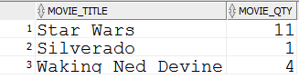
Rules of Precedence
SELECT movie_title, movie_qty
FROM mm_movie
WHERE movie_title like ‘S%'
OR movie_title like '_a%'
AND movie_qty > 3;
1

Slide 40
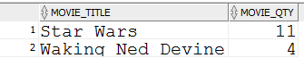
Rules of Precedence
SELECT movie_title, movie_qty
FROM mm_movie
WHERE (movie_title like ‘S%'
OR movie_title like '_a%‘)
AND movie_qty > 3;
2

Slide 41
Sorting

Slide 42
Sorting the results of a query
Suppose we are using the tables for our small movie rental store :

Slide 43
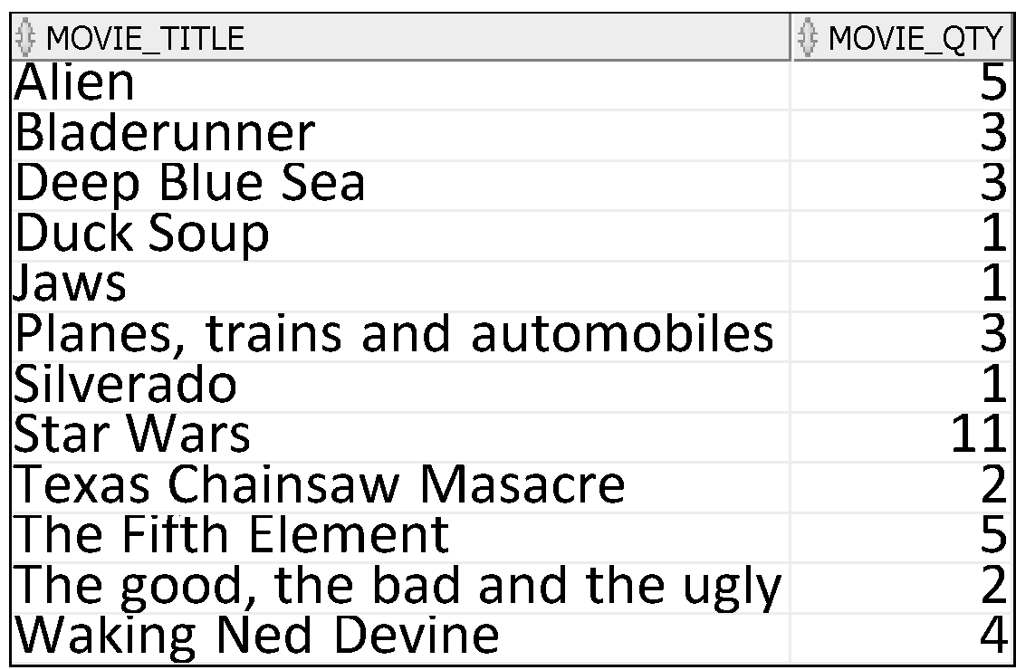
ORDER BY Clause
Sort retrieved rows with the ORDER BY clause:
ASC: ascending order, default
DESC: descending order
The ORDER BY clause comes last in the SELECT statement:
SELECT movie_title, movie_qty from mm_movie ORDER BY movie_title ASC;

Slide 44
SELECT movie_title, movie_qty from mm_movie
ORDER BY movie_qty DESC;
What will this SELECT statement return?

Slide 45
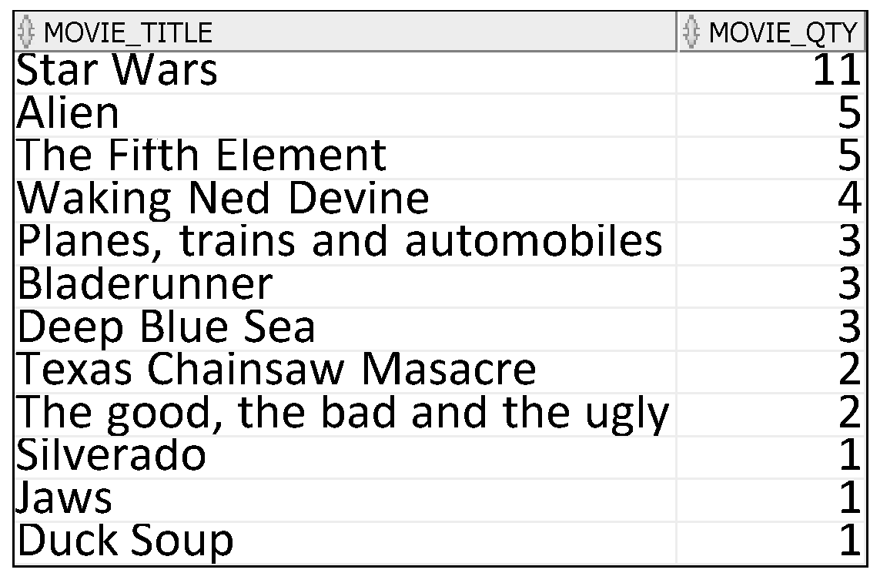
Returns the movie title and the quantity in stock of all movies in the mm_movie table sorted in descending order of quantity.

Slide 46
How does the SELECT statement work?

Slide 47
Sailors ( sid: integer, sname: string, rating: integer, age: real )
Reservations( sid: integer, bid: integer, day: date )
sid | sname | rating | age
22 | Dustin | 7 | 45.0
31 | Lubber | 8 | 55.5
58 | Rusty | 10 | 35
71 | Zorba | 10 | 16
74 | Horatio | 9 | 40
sid | bid | day
22 | 101 | 10/10/02
58 | 103 | 11/12/02
An instance R of Reservations
Reservations = Boats reserved by sailors
An instance S of Sailors

Slide 48
Q1. Find the names and ages of all sailors.
SELECT S.sname, S.age
FROM Sailors S
The corresponding
SQL query.
S (instance of Sailors)
sid | sname | rating | age
22 | Dustin | 7 | 45.0
31 | Lubber | 8 | 55.5
58 | Rusty | 10 | 35
71 | Zorba | 10 | 16
74 | Horatio | 9 | 40
Now, animate the
execution of the SQL query!

Slide 49
Q1. Find the names and ages of all sailors. [Step 0]
SELECT S.sname, S.age
FROM Sailors S
Result
S (instance of Sailors)
sid | sname | rating | age
22 | Dustin | 7 | 45.0
31 | Lubber | 8 | 55.5
58 | Rusty | 10 | 35
71 | Zorba | 10 | 16
74 | Horatio | 9 | 40
sname | age
Query result is also a database table.

Slide 50
Q1. Find the names and ages of all sailors. [Step 1]
SELECT S.sname, S.age
FROM Sailors S
Result
S (instance of Sailors)
sid | sname | rating | age
22 | Dustin | 7 | 45.0
31 | Lubber | 8 | 55.5
58 | Rusty | 10 | 35
71 | Zorba | 10 | 16
74 | Horatio | 9 | 40
sname | age
Dustin | 45.0
Output only the required fields
in this entry.

Slide 51
Q1. Find the names and ages of all sailors. [Step 2]
SELECT S.sname, S.age
FROM Sailors S
Result
S (instance of Sailors)
sid | sname | rating | age
22 | Dustin | 7 | 45.0
31 | Lubber | 8 | 55.5
58 | Rusty | 10 | 35
71 | Zorba | 10 | 16
74 | Horatio | 9 | 40
sname | age
Dustin | 45.0
Lubber | 55.5

Slide 52
Q1. Find the names and ages of all sailors. [Step 3]
SELECT S.sname, S.age
FROM Sailors S
Result
S (instance of Sailors)
sid | sname | rating | age
22 | Dustin | 7 | 45.0
31 | Lubber | 8 | 55.5
58 | Rusty | 10 | 35
71 | Zorba | 10 | 16
74 | Horatio | 9 | 40
sname | age
Dustin | 45.0
Lubber | 55.5
Rusty | 35

Slide 53
Q1. Find the names and ages of all sailors. [Step 4]
SELECT S.sname, S.age
FROM Sailors S
Result
S (instance of Sailors)
sid | sname | rating | age
22 | Dustin | 7 | 45.0
31 | Lubber | 8 | 55.5
58 | Rusty | 10 | 35
71 | Zorba | 10 | 16
74 | Horatio | 9 | 40
sname | age
Dustin | 45.0
Lubber | 55.5
Rusty | 35
Zorba | 16

Slide 54
Q1. Find the names and ages of all sailors. [Step 5]
SELECT S.sname, S.age
FROM Sailors S
Result
S (instance of Sailors)
sid | sname | rating | age
22 | Dustin | 7 | 45.0
31 | Lubber | 8 | 55.5
58 | Rusty | 10 | 35
71 | Zorba | 10 | 16
74 | Horatio | 9 | 40
sname | age
Dustin | 45.0
Lubber | 55.5
Rusty | 35
Zorba | 16
Horatio | 40

Slide 55
Q1. Find the names and ages of all sailors. [Step 6]
SELECT S.sname, S.age
FROM Sailors S
Result
S (instance of Sailors)
sid | sname | rating | age
22 | Dustin | 7 | 45.0
31 | Lubber | 8 | 55.5
58 | Rusty | 10 | 35
71 | Zorba | 10 | 16
74 | Horatio | 9 | 40
sname | age
Dustin | 45.0
Lubber | 55.5
Rusty | 35
Zorba | 16
Horatio | 40
End of
Algorithm

Slide 56
Summary of Q1:
Result of SQL query
is another table
derived from original table.
This query is also called a “projection”
It simply selected a subset of the columns

Slide 57
Q2. Find all sailors with a rating above 7.
SELECT S.sid, S.sname
FROM Sailors S
WHERE (S.rating > 7)
The corresponding
SQL query.
S (instance of Sailors)
sid | sname | rating | age
22 | Dustin | 7 | 45.0
31 | Lubber | 8 | 55.5
58 | Rusty | 10 | 35
71 | Zorba | 10 | 16
74 | Horatio | 9 | 40
Now, animate the
execution of the SQL query!

Slide 58
Q2. Find all sailors with a rating above 7. [Step 0]
SELECT S.sid, S.sname
FROM Sailors S
WHERE (S.rating > 7)
DBMS
S (instance of Sailors)
sid | sname | rating | age
22 | Dustin | 7 | 45.0
31 | Lubber | 8 | 55.5
58 | Rusty | 10 | 35
71 | Zorba | 10 | 16
74 | Horatio | 9 | 40
Result
sid | sname
Query result is also a database table.

Slide 59
Q2. Find all sailors with a rating above 7. [Step 1]
SELECT S.sid, S.sname
FROM Sailors S
WHERE (S.rating > 7)
DBMS
7 > 7?
No!
S (instance of Sailors)
Condition is false
Do not output
this entry.
sid | sname | rating | age
22 | Dustin | 7 | 45.0
31 | Lubber | 8 | 55.5
58 | Rusty | 10 | 35
71 | Zorba | 10 | 16
74 | Horatio | 9 | 40
Result
sid | sname

Slide 60
Q2. Find all sailors with a rating above 7. [Step 2]
SELECT S.sid, S.sname
FROM Sailors S
WHERE (S.rating > 7)
DBMS
8 > 7?
Yes.
S (instance of Sailors)
Condition is true
Output this entry.
sid | sname | rating | age
22 | Dustin | 7 | 45.0
31 | Lubber | 8 | 55.5
58 | Rusty | 10 | 35
71 | Zorba | 10 | 16
74 | Horatio | 9 | 40
Result
sid | sname
31 | Lubber

Slide 61
Q2. Find all sailors with a rating above 7. [Step 3]
SELECT S.sid, S.sname
FROM Sailors S
WHERE (S.rating > 7)
DBMS
10 > 7?
Yes.
S (instance of Sailors)
Condition is true
Output this entry.
sid | sname | rating | age
22 | Dustin | 7 | 45.0
31 | Lubber | 8 | 55.5
58 | Rusty | 10 | 35
71 | Zorba | 10 | 16
74 | Horatio | 9 | 40
Result
sid | sname
31 | Lubber
58 | Rusty

Slide 62
Q2. Find all sailors with a rating above 7. [Step 4]
SELECT S.sid, S.sname
FROM Sailors S
WHERE (S.rating > 7)
DBMS
10 > 7?
Yes.
S (instance of Sailors)
sid | sname | rating | age
22 | Dustin | 7 | 45.0
31 | Lubber | 8 | 55.5
58 | Rusty | 10 | 35
71 | Zorba | 10 | 16
74 | Horatio | 9 | 40
Result
sid | sname
31 | Lubber
58 | Rusty
71 | Zorba

Slide 63
Q2. Find all sailors with a rating above 7. [Step 5]
SELECT S.sid, S.sname
FROM Sailors S
WHERE (S.rating > 7)
DBMS
9 > 7?
Yes.
S (instance of Sailors)
sid | sname | rating | age
22 | Dustin | 7 | 45.0
31 | Lubber | 8 | 55.5
58 | Rusty | 10 | 35
71 | Zorba | 10 | 16
74 | Horatio | 9 | 40
Result
sid | sname
31 | Lubber
58 | Rusty
71 | Zorba
74 | Horatio

Slide 64
Q2. Find all sailors with a rating above 7. [Step 6]
SELECT S.sid, S.sname
FROM Sailors S
WHERE (S.rating > 7)
DBMS
S (instance of Sailors)
sid | sname | rating | age
22 | Dustin | 7 | 45.0
31 | Lubber | 8 | 55.5
58 | Rusty | 10 | 35
71 | Zorba | 10 | 16
74 | Horatio | 9 | 40
Result
sid | sname
31 | Lubber
58 | Rusty
71 | Zorba
74 | Horatio
End of
Algorithm

Slide 65
Summary of Q2:
Result of SQL query
is another table
row-inclusion is determined by where-clause.

Slide 66
Q3. Find the names of sailors who have reserved boat number 103.
SELECT S.name
FROM Sailors S, Reservations R
WHERE (S.sid = R.sid) AND (R.bid = 103)
The corresponding
SQL query.
DB (2 tables)
sid | sname | rating | age
22 | Dustin | 7 | 45.0
31 | Lubber | 8 | 55.5
58 | Rusty | 10 | 35
sid | bid | day
22 | 101 | 10/10/02
58 | 103 | 11/12/02
An instance R of Reservations
IMPORTANT:
This specifies how S and R are to be joined together.
An instance S of Sailors
This query requires information from both tables S and R.
To answer this query, a JOIN operation needs to be performed.

Slide 67
Q3. Find the names of sailors who have reserved boat number 103.
SELECT S.name
FROM Sailors S, Reservations R
WHERE (S.sid = R.sid) AND (R.bid = 103)
S (instance of Sailors)
Overview:
A JOIN operation works as follows:
for each row in table S;
+ try to “join” with each row in R
(match the “where” conditions)
sid | sname | rating | age
22 | Dustin | 7 | 45.0
31 | Lubber | 8 | 55.5
58 | Rusty | 10 | 35
Analysis:
So, a JOIN takes O(nm) row operations
where n = size of table S, and m = size of table R.
R (instance of Reservations)
sid | bid | day
22 | 101 | 10/10/02
58 | 103 | 11/12/02

Slide 68
Q3. Find the names of sailors who have reserved boat number 103.
SELECT S.name
FROM Sailors S, Reservations R
WHERE (S.sid = R.sid) AND (R.bid = 103)
DBMS
S (instance of Sailors)
Result
S.sid = 22
sid | sname | rating | age
22 | Dustin | 7 | 45.0
31 | Lubber | 8 | 55.5
58 | Rusty | 10 | 35
sname
R.sid = 22
(S.sid = R.sid)
R.bid = 101
(R.bid ≠ 103) !
R (instance of Reservations)
sid | bid | day
22 | 101 | 10/10/02
58 | 103 | 11/12/02
Condition is false
Do not output
this entry.

Slide 69
Q3. Find the names of sailors who have reserved boat number 103.
SELECT S.name
FROM Sailors S, Reservations R
WHERE (S.sid = R.sid) AND (R.bid = 103)
DBMS
S (instance of Sailors)
Result
S.sid = 22
sid | sname | rating | age
22 | Dustin | 7 | 45.0
31 | Lubber | 8 | 55.5
58 | Rusty | 10 | 35
sname
R.sid = 58
(S.sid ≠ R.sid) !
R (instance of Reservations)
sid | bid | day
22 | 101 | 10/10/02
58 | 103 | 11/12/02
Condition is false
Do not output
this entry.

Slide 70
Q3. Find the names of sailors who have reserved boat number 103.
SELECT S.name
FROM Sailors S, Reservations R
WHERE (S.sid = R.sid) AND (R.bid = 103)
DBMS
S (instance of Sailors)
Result
S.sid = 31
sid | sname | rating | age
22 | Dustin | 7 | 45.0
31 | Lubber | 8 | 55.5
58 | Rusty | 10 | 35
sname
R.sid = 22
(S.sid ≠ R.sid) !
R (instance of Reservations)
sid | bid | day
22 | 101 | 10/10/02
58 | 103 | 11/12/02
Condition is false
Do not output
this entry.

Slide 71
Q3. Find the names of sailors who have reserved boat number 103.
SELECT S.name
FROM Sailors S, Reservations R
WHERE (S.sid = R.sid) AND (R.bid = 103)
DBMS
S (instance of Sailors)
Result
S.sid = 31
sid | sname | rating | age
22 | Dustin | 7 | 45.0
31 | Lubber | 8 | 55.5
58 | Rusty | 10 | 35
sname
R.sid = 58
(S.sid ≠ R.sid) !
R (instance of Reservations)
sid | bid | day
22 | 101 | 10/10/02
58 | 103 | 11/12/02
Condition is false
Do not output
this entry.

Slide 72
Q3. Find the names of sailors who have reserved boat number 103.
SELECT S.name
FROM Sailors S, Reservations R
WHERE (S.sid = R.sid) AND (R.bid = 103)
DBMS
S (instance of Sailors)
Result
S.sid = 58
sid | sname | rating | age
22 | Dustin | 7 | 45.0
31 | Lubber | 8 | 55.5
58 | Rusty | 10 | 35
sname
R.sid = 22
(S.sid ≠ R.sid) !
R (instance of Reservations)
sid | bid | day
22 | 101 | 10/10/02
58 | 103 | 11/12/02
Condition is false
Do not output
this entry.

Slide 73
Q3. Find the names of sailors who have reserved boat number 103.
SELECT S.name
FROM Sailors S, Reservations R
WHERE (S.sid = R.sid) AND (R.bid = 103)
DBMS
S (instance of Sailors)
Result
S.sid = 58
sid | sname | rating | age
22 | Dustin | 7 | 45.0
31 | Lubber | 8 | 55.5
58 | Rusty | 10 | 35
sname
R.sid = 58
Rusty
(S.sid = R.sid) !
R.bid = 103
(R.bid = 103) !
R (instance of Reservations)
sid | bid | day
22 | 101 | 10/10/02
58 | 103 | 11/12/02
Condition is true
Output this entry.

Slide 74
Q3. Find the names of sailors who have reserved boat number 103.
SELECT S.name
FROM Sailors S, Reservations R
WHERE (S.sid = R.sid) AND (R.bid = 103)
DBMS
S (instance of Sailors)
Result
sid | sname | rating | age
22 | Dustin | 7 | 45.0
31 | Lubber | 8 | 55.5
58 | Rusty | 10 | 35
sname
Rusty
End of
Algorithm
R (instance of Reservations)
sid | bid | day
22 | 101 | 10/10/02
58 | 103 | 11/12/02

Slide 75
Summary of Q3:
Result of SQL query requires
information from two tables
a JOIN operation is necessary
Joins are EXPENSIVE operations.

Slide 76
Q3 = Inner Join
We know that to answer our query we need to use two tables
We know that the two tables have a column in common
They are linked by this column
Values in the column in one table can be used to look up the other table
Only rows that match search conditions are returned
I.E. only rows where the values in the common column match are returned
SELECT S.name
FROM Sailors S, Reservations R
WHERE (S.sid = R.sid)
Returns only those sailors who have reserved boats
We tell the DBMS which column is common to both tables

Slide 77
Q3 = Inner Join
More correct way is to tell the DBMS that these two tables are joined by design
SELECT s.sid, s.name, r.bid
FROM Sailors s INNER JOIN Reservations r
ON s.sid = r.sid
Join SAILORS to RESERVATIONS using the column sid in both tables
Returns only those sailors who have reserved boats
We tell the DBMS which column is common to both tables
This does exactly what we did above using a where clause

Slide 78
Natural Join
SQL also allows:
SELECT s.sid, s.name, r.bid
FROM Sailors s NATURAL JOIN Reservation r
“NATURAL” means equi-join for each pair of attributes with the same name
You don’t specify, will match on all columns which have the same name
While this might seem to be easy, usually we want to be in control of the linking of tables in a query so this is rarely used.

Slide 79
Putting it all together

Slide 80
Inner Joins
Suppose we want to achieve the following
Return the names and categories of all movies sorted in order of category showing the name of the category rather than the ID
What do we need to do?

Slide 81
Inner Join
What are the pieces of data we want to get back?
Name of the movie
Name of the category
Where are these pieces of data found?
MM_MOVIE
MM_MOVIE_TYPE

Slide 82
Inner Join
How will we make sure that for each movie we get the correct category?
Need to tell DBMS to use the value of category ID in the MM_MOVIE table to look up the MM_MOVIE_TYPE table
Need to tell it which column is the link between the two
MM_MOVIE column is MOVIE_TYPE_ID
MM_MOVIE_TYPE column is MOVIE_TYPE_ID

Slide 83
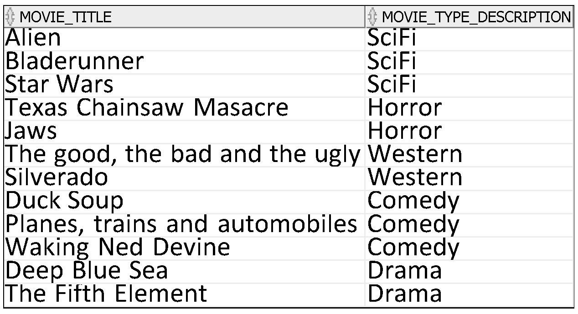
Inner Join
SELECT movie_title, movie_type_description
from mm_movie
join mm_movie_type
on mm_movie.movie_type_id=mm_movie_type.movie_type_id;

Slide 84
Inner Join
SELECT movie_title, movie_type_description
from mm_movie
join mm_movie_type
on mm_movie.movie_type_id=mm_movie_type.movie_type_id;
Because the columns we are linking on are the same name, the DBMS will be confused unless we tell it which table it should look in for each column

Slide 85
Inner Join
Suppose now we only wanted to find movies from a category with the letter o somewhere in its name?
We want to return the title of the movie and the name of the category

Slide 86
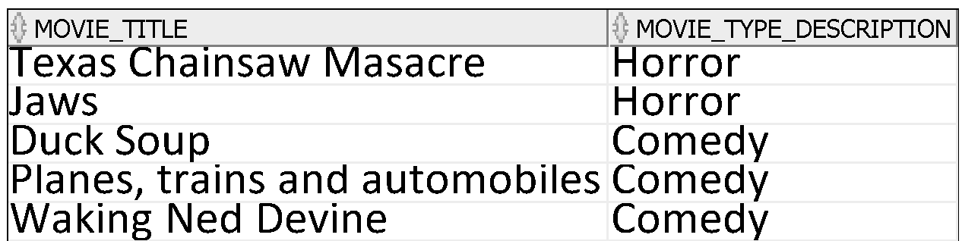
Using a Comparator
Suppose now we only wanted to find movies from a category with the letter o somewhere in its name?
SELECT movie_title , movie_type_description
FROM mm_movie
JOIN MM_MOVIE_TYPE
ON MM_MOVIE.MOVIE_TYPE_ID=MM_MOVIE_TYPE.MOVIE_TYPE_ID
WHERE MOVIE_TYPE_DESCRIPTION like '%o%';

Slide 87
Adding in a sort
And sort the output in order of movie_title?

Slide 88
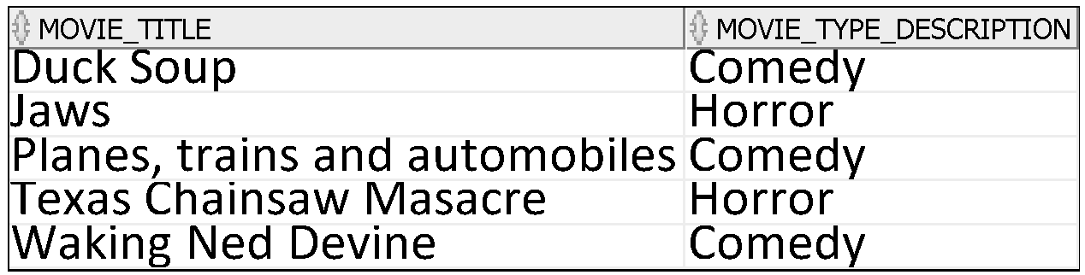
Adding in a sort
And sort the output in order of movie_title?
SELECT movie_title , movie_type_description
FROM mm_movie
JOIN MM_MOVIE_TYPE
ON MM_MOVIE.MOVIE_TYPE_ID=MM_MOVIE_TYPE.MOVIE_TYPE_ID
WHERE MOVIE_TYPE_DESCRIPTION like '%o%'
ORDER BY MOVIE_TITLE ;

Slide 89
Including a logical operator
Suppose now we only wanted to find movies from a category with the letter o somewhere in its name or an a in its name and where the quantity is more than 3?
We want to return the title of the movie, the name of the category and the quantity of the movie

Slide 90

Including a logical operator
SELECT movie_title , movie_type_description , movie_qty
FROM mm_movie
JOIN MM_MOVIE_TYPE
ON MM_MOVIE.MOVIE_TYPE_ID=MM_MOVIE_TYPE.MOVIE_TYPE_ID
WHERE MOVIE_TYPE_DESCRIPTION like '%o%'
AND MOVIE_QTY <3
ORDER BY MOVIE_TITLE ;

Slide 91
And Again

Slide 92
Inner Joins
Suppose we want to achieve the following
Return the check out date of each rental and the name of the movie that has been rented
What do we need to do?

Slide 93
Inner Join
What are the pieces of data we want to get back?
Date of the rental
Name of the movie
Where are these pieces of data found?
MM_RENTAL
MM_MOVIE
How will we make sure that for each movie we get the correct title?
Need to tell DBMS to use the value of MOVIE_ID in the MM_RENTAL table to look up MM_MOVIE table
Need to tell it which column is the link between the two

Slide 94
Inner Join
What are the pieces of data we want to get back?
Date of rental
Name of the movie
Where are these pieces of data found?
MM_RENTAL
MM_MOVIE
What are the column names?
CHECKOUT_DATE(MM_RENTAL)
MOVIE_TITLE(MM_MOVIE)

Slide 95
Inner Join
How will we make sure that for each movie we get the correct category?
Need to tell DBMS to use the value of MOVIE_ID in the MM_RENTAL table to look up MM_MOVIE
Need to tell it which column is the link between the two
MM_RENTAL column is MOVIE_ID
MM_MOVIE column is MOVIE_ID

Slide 96
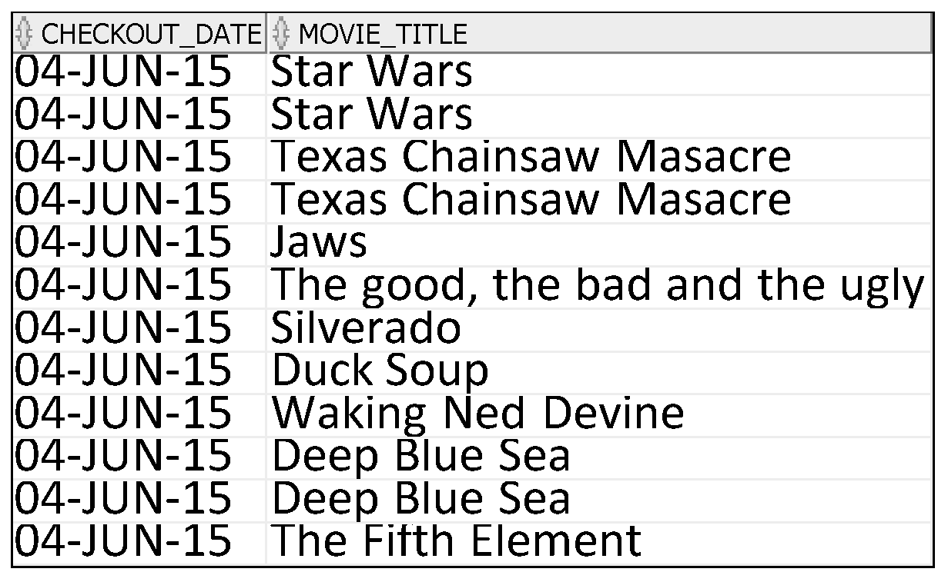
Inner Join
SELECT checkout_date, movie_title
FROM MM_RENTAL
JOIN MM_MOVIE
ON MM_RENTAL.MOVIE_ID=MM_MOVIE.MOVIE_ID;

Slide 97
Inner Join
SELECT checkout_date, movie_title
FROM MM_RENTAL
JOIN MM_MOVIE
ON MM_RENTAL.MOVIE_ID=MM_MOVIE.MOVIE_ID;
Because the columns we are linking on are the same name, the DBMS will be confused unless we tell it which table it should look in for each column

Slide 98
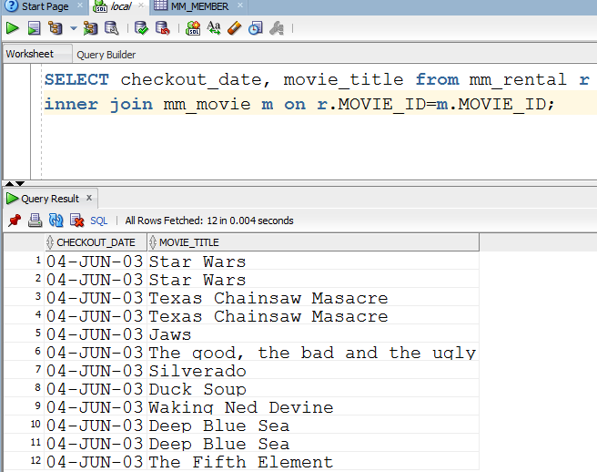
Inner Join
Rather than using the full name of the title we can use a shorthand or alias. In this case we are using m for the mm_movie table and r for the mm_rental table

Slide 99
Inner Join
Suppose now we only wanted to find movies rented by a range of customers (those with IDs between 12 and 14)?
We want to return the title of the movie, the date checked out, and the id of the customer

Slide 100
Using a Comparator
Suppose now we only wanted to find movies rented by a range of customers (IDs between 12 and 14)?
SELECT checkout_date, movie_title, customer_id
FROM mm_rental r
INNER JOIN mm_movie m on r.MOVIE_ID=m.MOVIE_ID
WHERE r.customer_id between 12 and 14;

Slide 101
Adding in a sort
And sort the output in descending order of movie_title?

Slide 102
Adding in a sort
And sort the output in descending order of movie_title?
SELECT checkout_date, movie_title, customer_id
FROM mm_rental r
INNER JOIN mm_movie m on r.MOVIE_ID=m.MOVIE_ID
WHERE r.customer_id between 12 and 14
ORDER BY movie_title DESC;

Slide 103
Including a logical operator
Suppose now we only wanted to find movies with a qty of less than 3 borrowed by our customers between 12 and 14?
We want to return the title of the movie, the checkout date, the customer ID and the quantity of the movie

Slide 104
Including a logical operator
Suppose now we only wanted to find movies with a qty of less than 3 borrowed by our members between 12 and 14?
We want to return the title of the movie, the checkout date, the member ID and the quantity of the movie
SELECT checkout_date, movie_title, customer_id, movie_qty
FROM mm_rental r
INNER JOIN mm_movie m on r.MOVIE_ID=m.MOVIE_ID
WHERE r.customer_id between 12 and 14
AND m.movie_qty <3
ORDER BY movie_title DESC;

Slide 105
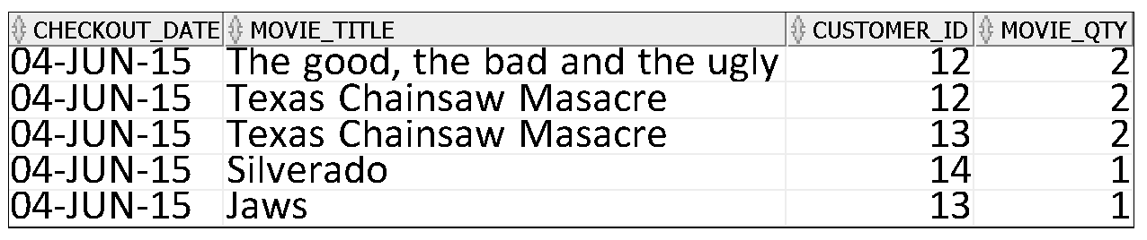
Including a logical operator
SELECT checkout_date, movie_title, customer_id, movie_qty
FROM mm_rental r
INNER JOIN mm_movie m on r.MOVIE_ID=m.MOVIE_ID
WHERE r.customer_id between 12 and 14
AND m.movie_qty <3
ORDER BY movie_title DESC;

Slide 106
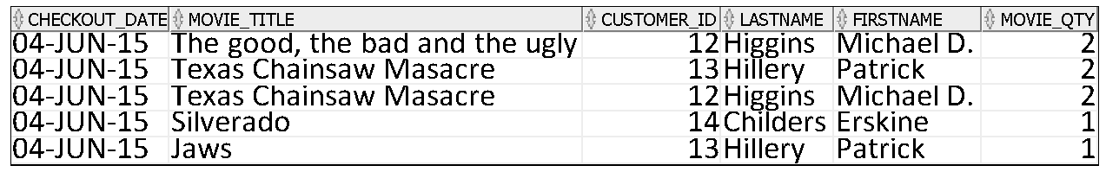
Including the customer name (Join mm_rental to two tables)
SELECT checkout_date, movie_title, r.customer_id, last_name, first_name, movie_qty
FROM mm_rental r
INNER JOIN mm_movie m on r.MOVIE_ID=m.MOVIE_ID
INNER JOIN mm_customer c on r.customer_ID= c.customer_ID
WHERE r.customer_id between 12 and 14
AND m.movie_qty <3
ORDER BY movie_title DESC;
Need to identify which table to use to retrieve value of customer_id

Slide 107
Making the Relationship More Formal
Foreign Keys

Slide 108
Constraints
Oracle provides you with different constraints
to specify a primary or a composite key for the table,
to define a foreign key in a table that references a primary key in another table,
to set data validation rules for each column,
to specify whether a column allows NULL values,
and to specify if a column should have unique values only.

Slide 109
Constraints
Constraints are rules that the data must follow to get into the table.
Preserve the integrity of the data in the databases.
Data Integrity refers to the validity of data.
Are your data valid? Are your data representing what you have designed them to?
Ensures that no one can insert data that does not conform to your rules
Which ensures that whoever uses your data can be confidence that the data will be consistent.
Constraints enforce rules at the table level.
Constraints prevent the deletion of a table if there are dependencies.

Slide 110
Key Constraints
Define both the primary key
Uniquely identifies each instance of an entity
AND
Any foreign keys
Links between this table and others it references.

Slide 111
Key Constraints – Primary Key
Enforce entity integrity by uniquely identifying entity instances.
Is an attribute or a set of attributes that uniquely identify a specific instance of an entity.
Every entity in the data model must have a primary key whose values uniquely identify instances of the entity.

Slide 112
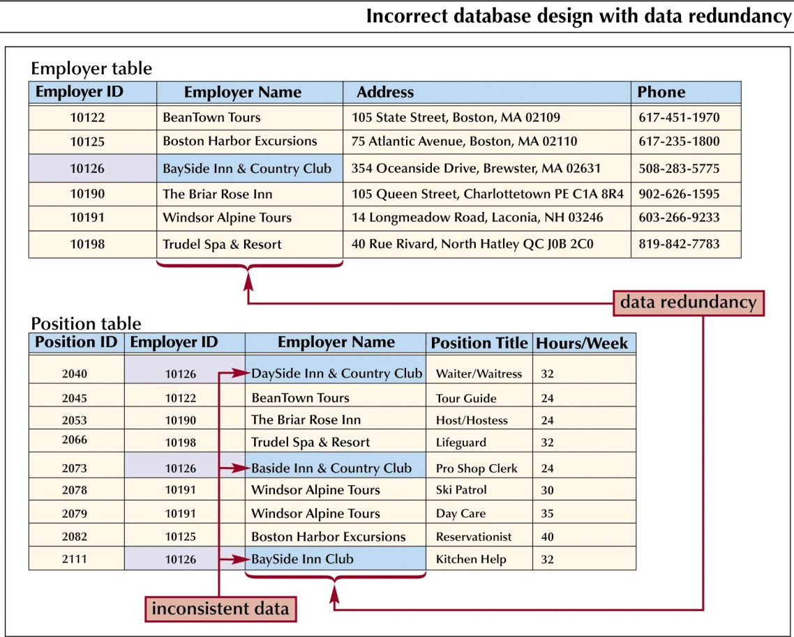
Data redundancy
Duplication of data in separate tables
Leads to waste and potential inconsistency
How to overcome this?

Slide 113
Key Constraints - Foreign Key
An attribute of one table that represents the relationship between this table and another
The attribute is the primary key of the other table
Foreign keys provide a method for maintaining integrity in the data (called referential integrity) and for navigating between different instances of an entity.
Every relationship between tables must be supported by a foreign key.
Foreign keys attributes are indicated by the notation (FK) beside them on database models.

Slide 114
Key constraints
Suppose we have the following relations (equivalent to tables):
CUSTOMER(Customer_ID, Customer_Name, Address, City, State, Zip)
PRODUCT(Product_ID, Product_Description, Product_Finish, Standard_Price, On_Hand)
ORDER(Order_ID, Order_Date, Customer_ID)
ORDER_LINE(Order_ID, Product_ID, Quantity)
The underlined attributes are the primary keys.
The primary key for ORDER_LINE is a composite key consisting of the attributes Order_ID and Product_ID
Customer_ID is a foreign key in the ORDER relation, allowing an order to be associated with a customer
ORDER_LINE has two foreign keys, Order_ID and Product_ID, allowing each line on an order with the relevant order and product.

Slide 115
Foreign Key
When one table needs to be related to another table, you must include a common field and tell Oracle that the tables are linked.
The common field will be the primary key in one table.
The field in the related table is referred to as the foreign key.
The foreign key in a table can then be used as a primary key to access the record in the related table when needed.
It also helps enforce data integrity.
A foreign key value must match an existing value in the parent table or be NULL.
Therefore it is not possible to insert invalid data into the foreign key field.
Foreign keys are based on data values and are purely logical, rather than physical, pointers.

Slide 116
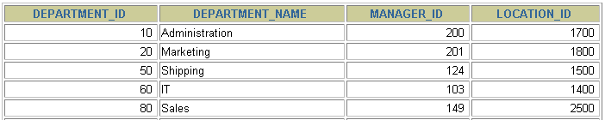
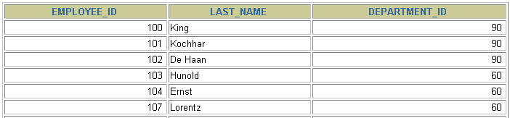
FOREIGN KEY Constraint
DEPARTMENTS
PRIMARY KEY
…
EMPLOYEES
FOREIGN KEY
…
INSERT INTO
Not allowed (9 does not exist)
Allowed
Notes:
FOREIGN KEY Constraint
The FOREIGN KEY (or referential integrity) constraint designates a column or combination of columns as a foreign key and establishes a relationship between a primary key or a unique key in the same table or a different table.
In the example in the slide, DEPARTMENT_ID has been defined as the foreign key in the EMPLOYEES table (dependent or child table); it references the DEPARTMENT_ID column of the DEPARTMENTS table (the referenced or parent table).
Guidelines

Slide 117
Defining Foreign Key
To define a foreign key between Table A and Table B
When creating Table A include the following constraint:
CONSTRAINT <name of constraint> FOREIGN KEY (name of the column in Table A) REFERENCES (name of Table B) (name of column in Table B)

Slide 118
FOREIGN KEY Constraint: Keywords
FOREIGN KEY: Defines the column in the child table at the table-constraint level
REFERENCES: Identifies the table and column in the parent table
ON DELETE CASCADE: Deletes the dependent rows in the child table when a row in the parent table is deleted
ON DELETE SET NULL: Converts dependent foreign key values to null
Notes:
FOREIGN KEY Constraint: Keywords
The foreign key is defined in the child table, and the table containing the referenced column is the parent table. The foreign key is defined using a combination of the following keywords:
FOREIGN KEY is used to define the column in the child table at the table-constraint level.
REFERENCES identifies the table and column in the parent table.
ON DELETE CASCADE indicates that when the row in the parent table is deleted, the dependent rows in the child table are also deleted.
ON DELETE SET NULL converts foreign key values to null when the parent value is removed.
The default behavior is called the restrict rule, which disallows the update or deletion of referenced data.
Without the ON DELETE CASCADE or the ON DELETE SET NULL options, the row in the parent table cannot be deleted if it is referenced in the child table.

Slide 119
FOREIGN KEY Constraint
Defined at either the table level or the column level:
CREATE TABLE employees(
employee_id NUMBER(6),
last_name VARCHAR2(25) NOT NULL,
email VARCHAR2(25),
salary NUMBER(8,2),
commission_pct NUMBER(2,2),
hire_date DATE NOT NULL,
...
department_id NUMBER(4),
CONSTRAINT emp_dept_fk FOREIGN KEY (department_id)
REFERENCES departments(department_id),
CONSTRAINT emp_email_uk UNIQUE(email));
Notes:
FOREIGN KEY Constraint (continued)
FOREIGN KEY constraints can be defined at the column or table constraint level. A composite foreign key must be created by using the table-level definition.
The example in the slide defines a FOREIGN KEY constraint on the DEPARTMENT_ID column of the EMPLOYEES table, using table-level syntax. The name of the constraint is EMP_DEPTID_FK.
The foreign key can also be defined at the column level, provided the constraint is based on a single column. The syntax differs in that the keywords FOREIGN KEY do not appear. For example:
CREATE TABLE employees
(...
department_id NUMBER(4) CONSTRAINT emp_deptid_fk
REFERENCES departments(department_id),
...
)

Slide 120
CREATE TABLE: Employees Example
CREATE TABLE employees
( employee_id NUMBER(6)
CONSTRAINT emp_employee_id PRIMARY KEY
, first_name VARCHAR2(20)
, last_name VARCHAR2(25)
CONSTRAINT emp_last_name_nn NOT NULL
, email VARCHAR2(25)
CONSTRAINT emp_email_nn NOT NULL
CONSTRAINT emp_email_uk UNIQUE
, phone_number VARCHAR2(20)
, hire_date DATE
CONSTRAINT emp_hire_date_nn NOT NULL
, job_id VARCHAR2(10)
CONSTRAINT emp_job_nn NOT NULL
, salary NUMBER(8,2)
CONSTRAINT emp_salary_ck CHECK (salary>0)
, commission_pct NUMBER(2,2)
, manager_id NUMBER(6)
, department_id NUMBER(4)
CONSTRAINT emp_dept_fk REFERENCES
departments (department_id));
Notes:
The CREATE TABLE Example
The example shows the statement used to create the EMPLOYEES table in the HR schema.

